Slide 1
Lab 6 RPC Programming

Slide 2
Guideline
Read text materials and practice TCP/UDP Socket Programming
Use your notebook PC to examine context and produce the source code when you finish the successful practice.
Objectives
Understand the UDP server/client programming mechanism
Learn the usage of multi-process, multi-thread and I/O multiplexing
Practice
1. UDP Programming Test
2. Multi-process server programming
3. I/O multiplexing (Select / Poll) server programming

Slide 3
Running the Application Example

Slide 4
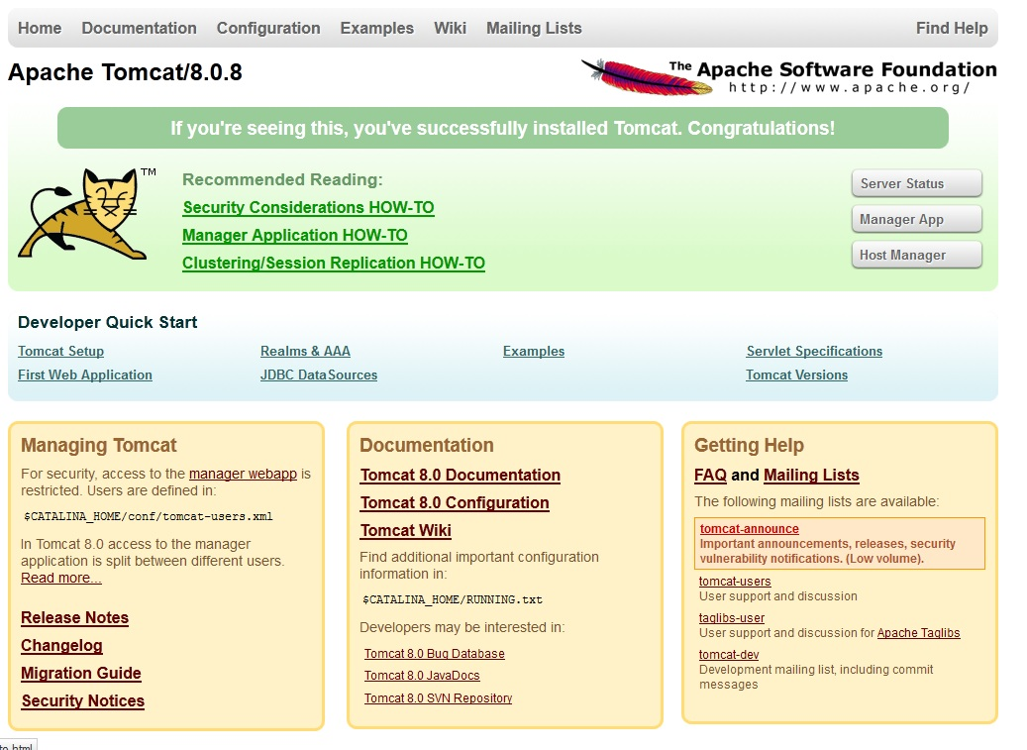
Apache Tomcat
Apache Tomcat, often referred to as Tomcat Server, is an open-source Java Servlet Container developed by the Apache Software Foundation (ASF).
Tomcat implements several Java EE specifications including Java Servlet and JavaServer Pages (JSP), and provides a HTTP web server environment

Slide 5
Setup Steps for Tomcat development environment
Download & Install Java S/W Development Kit
Download a server (Apache Tomcat 7)
Test server (Apache Tomcat 7)
Set up development environment
Create custom Web Application
Deploy a Web Application

Slide 6
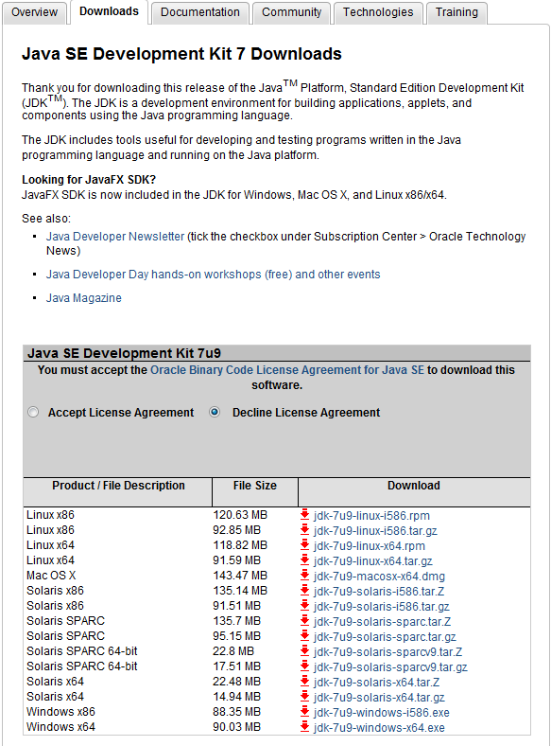
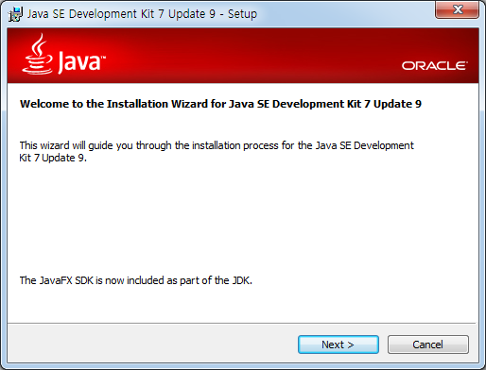
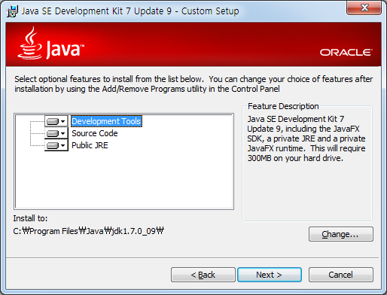
Download & Install JDK 7
http://www.oracle.com/technetwork/java/javase/downloads/jdk7u9-downloads-1859576.html
Download JDK
1
2

Slide 7
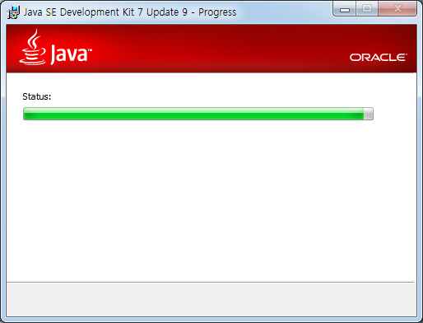
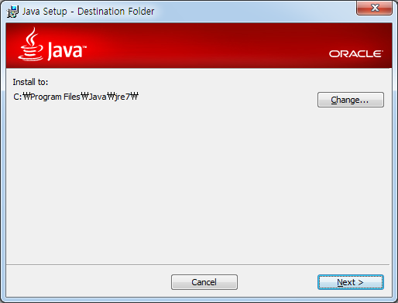
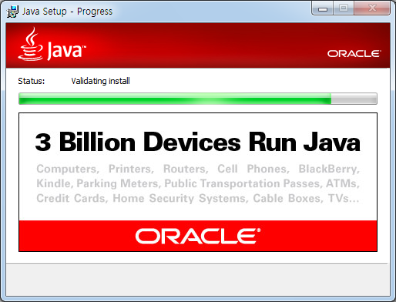
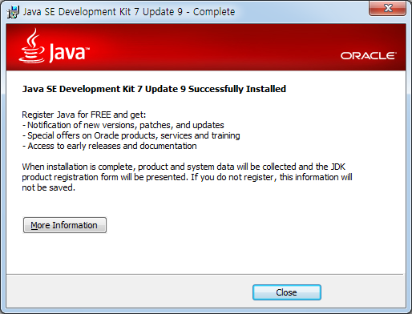
Install JDK 7
3
4
5
6

Slide 8
Install Web Server (Apache Tomcat)
What is Tomcat?
Tomcat is an open source server from the Apache Software Foundation. It is a Web application server, which means that it comes ready to support programming using JavaServer Pages (JSPs) and servlets.

Slide 9
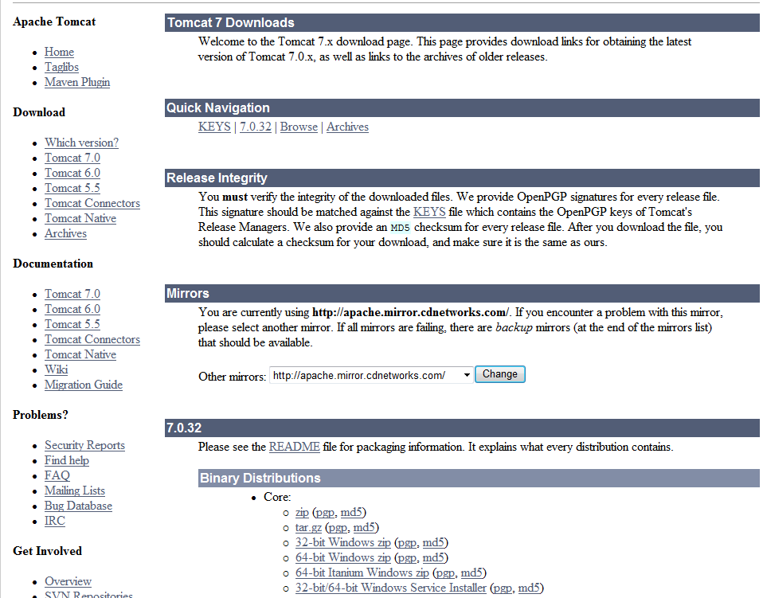
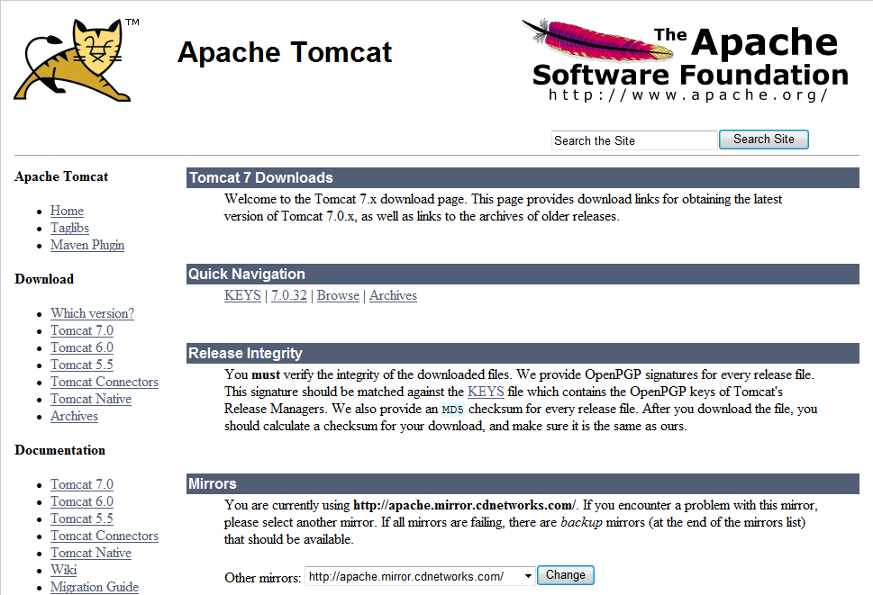
Download Apache Tomcat
Download :
32-bit/64-bit Windows Service Installer
http://tomcat.apache.org

Slide 10
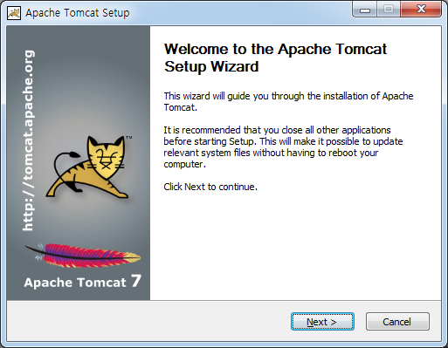
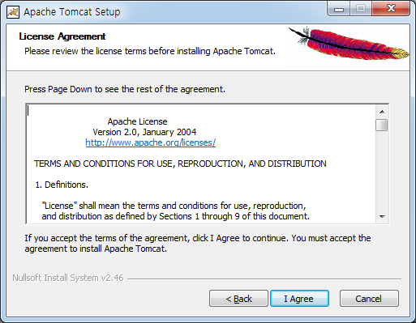
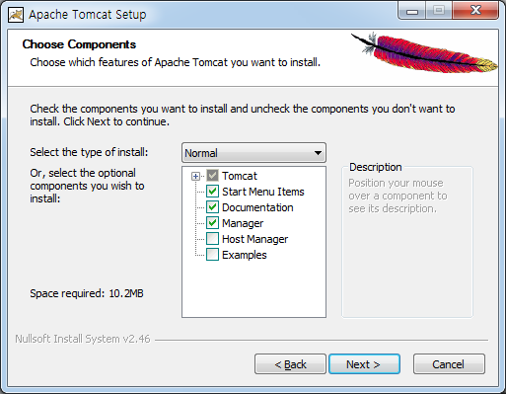
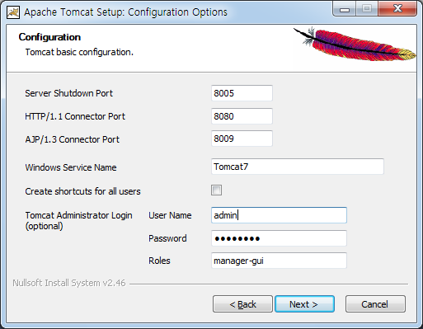
Install Apache Tomcat (1)
1
2
3
4
Enter User Name & Password

Slide 11
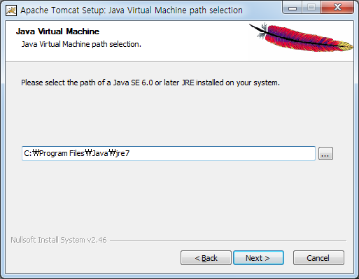
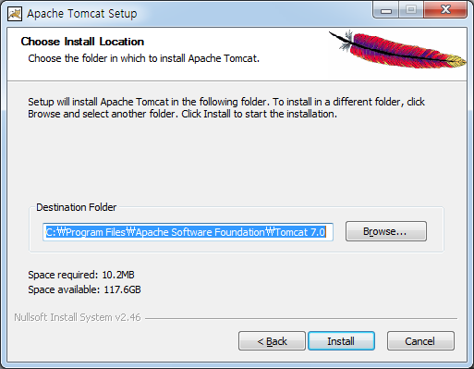
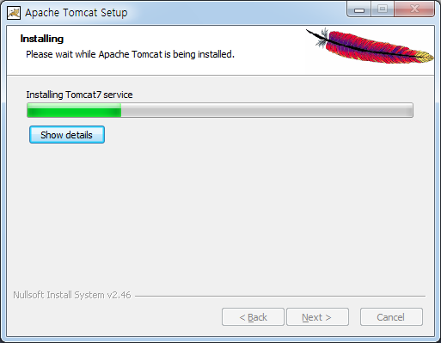
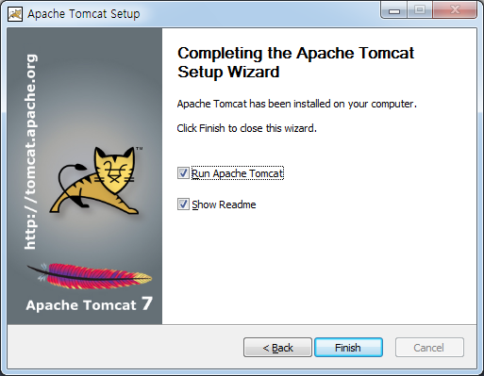
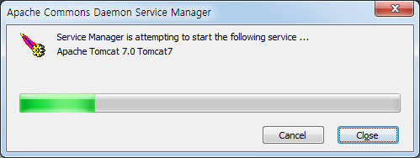
Install Apache Tomcat (2)
5
6
7
8
9

Slide 12
Install Apache Tomcat in Ubuntu
sudo apt-get install openjdk-7-jre-headless
sudo apt-get install tomcat7
service tomcat7 start
netstat -ntl

Slide 13
Install Apache Tomcat in Mac
brew install cask java
brew install tomcat
/{TOMCAT HOME}/bin/startup.sh

Slide 14
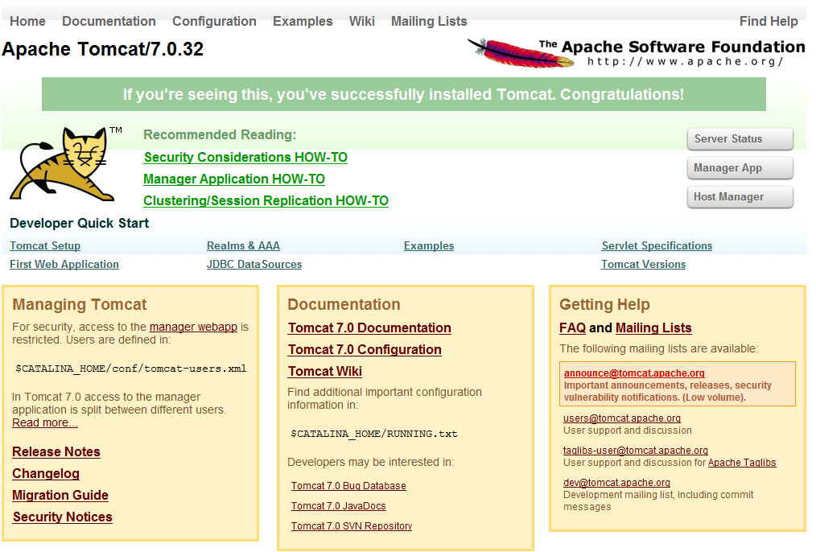
Management Web Page
http://localhost:8080/ or http://[Host IP Address]:8080/

Slide 15
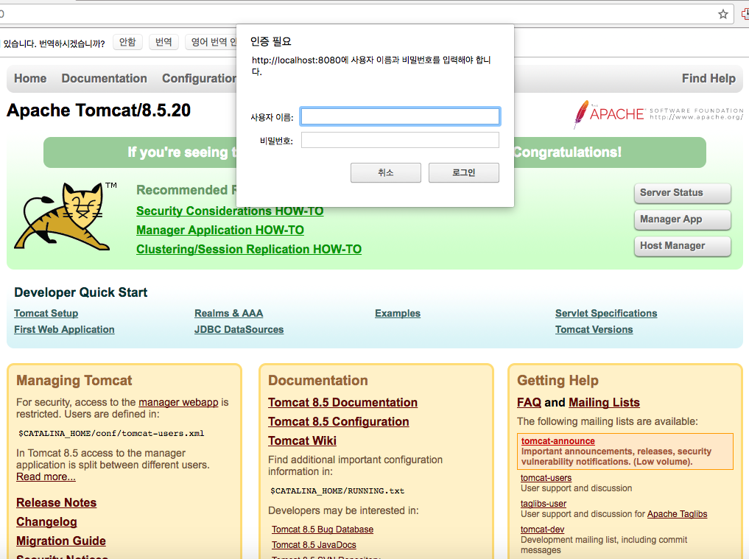
Authentication Problem
User account should be created!

Slide 16
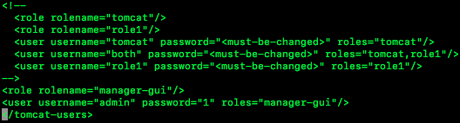
Create tomcat users
Edit the /[TOMCAT HOME]/conf/tomcat-users.xml
Location of TOMCAT HOME
Ubuntu: /etc/tomcat{version}/
Mac: /usr/local/Cellar/tomcat/{version}/libexec
Add role named ‘manager-gui’
Add user with your username and password with roles ‘manage-gui’
This user now can control GUI manager

Slide 17
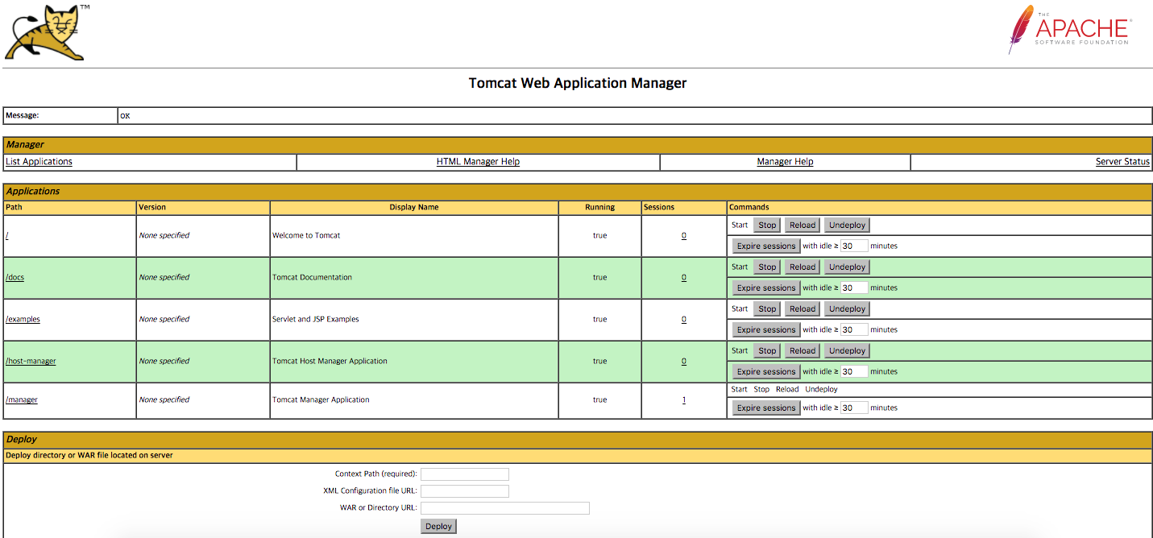
Manage Services
We can life cycle of service (start /stop / restart / terminate)
There is already existing services including docs, examples, etc…

Slide 18
Example
Chat example http://localhost:8080/examples/websocket/chat.xhtml
Snake example http://localhost:8080/examples/websocket/snake.xhtml
Draw example http://localhost:8080/examples/websocket/drawboard.xhtml
Together http://143.248.xxx.xxx:8080/examples/websocket/chat.xhtml

Slide 19
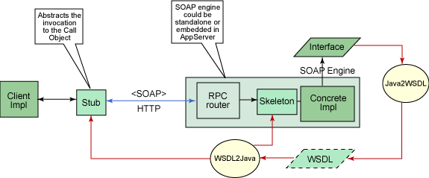
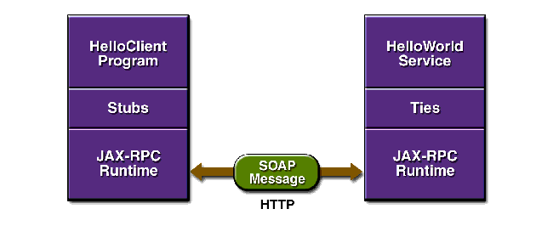
RPC Example
DemoRPCServer
Has the procedure “helloworld” that is called by clients
DemoRPCClient
Calls, “helloworld”, the procedure which is located RPCServer
Interfacing
XML-based WSDL(Web Service Description Language) is used as an IDL(interface Description Language)

Slide 20
Interface Description (similar to Skeleton)
package hello;
import java.rmi.Remote;
import java.rmi.RemoteException;
public interface HelloIF extends Remote {
public String sayHello(String s) throws RemoteException;
}

Slide 21
DemoRPCServer
package hello;
public class HelloImpl implements HelloIF {
public String message = "Hello ";
public String sayHello(String s) {
return message + s;
}
}

Slide 22
Jaxrpc-ri.xml (for war packaging)
<?xml version="1.0" encoding="UTF-8"?>
<webServices
xmlns="http://java.sun.com/xml/ns/jax-rpc/ri/dd"
version="1.0"
targetNamespaceBase="http://com.test/wsdl"
typeNamespaceBase="http://com.test/types"
urlPatternBase="/ws">
<endpoint
name="MyHello"
displayName="HelloWorld Service"
description="A simple web service"
interface="hello.HelloIF"
implementation="hello.HelloImpl"/>
<endpointMapping
endpointName="MyHello"
urlPattern="/hello"/>
</webServices>

Slide 23
Deploy war into Tomcat server and WSDL file
<?xml version="1.0" encoding="UTF-8"?>
<configuration
xmlns="http://java.sun.com/xml/ns/jax-rpc/ri/config">
<wsdl location=
"http://localhost:8080/hello-jaxrpc/hello?WSDL"
packageName="hello"/>
</configuration>

Slide 24
DemoRPCClient
package hello;
import javax.xml.rpc.Stub;
public class HelloClient {
public static void main(String[] args) {
try {
Stub stub = createProxy();
HelloIF hello = (HelloIF)stub;
System.out.println(hello.sayHello(”Foo"));
} catch (Exception ex) {
ex.printStackTrace();
}
}
private static Stub createProxy() { // Note: MyHello_Impl is implementation-specific.
return (Stub)(new MyHello_Impl().getHelloIFPort());
}
}

Slide 25
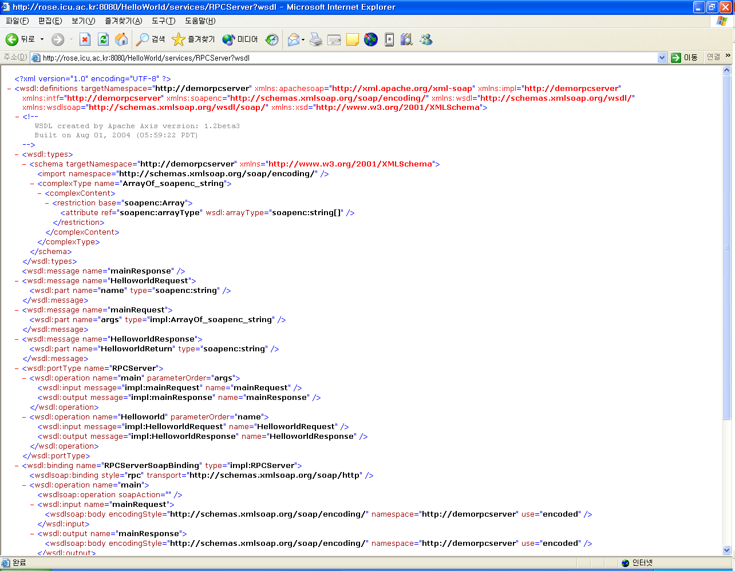
WSDL as an IDL

Slide 26
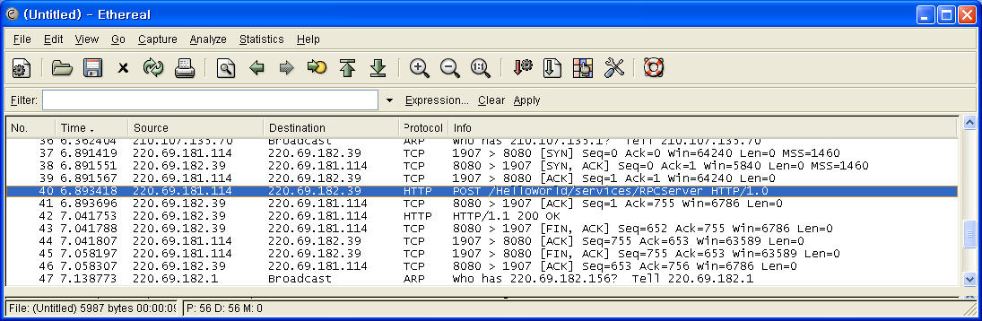
Protocol of RPC

Slide 27
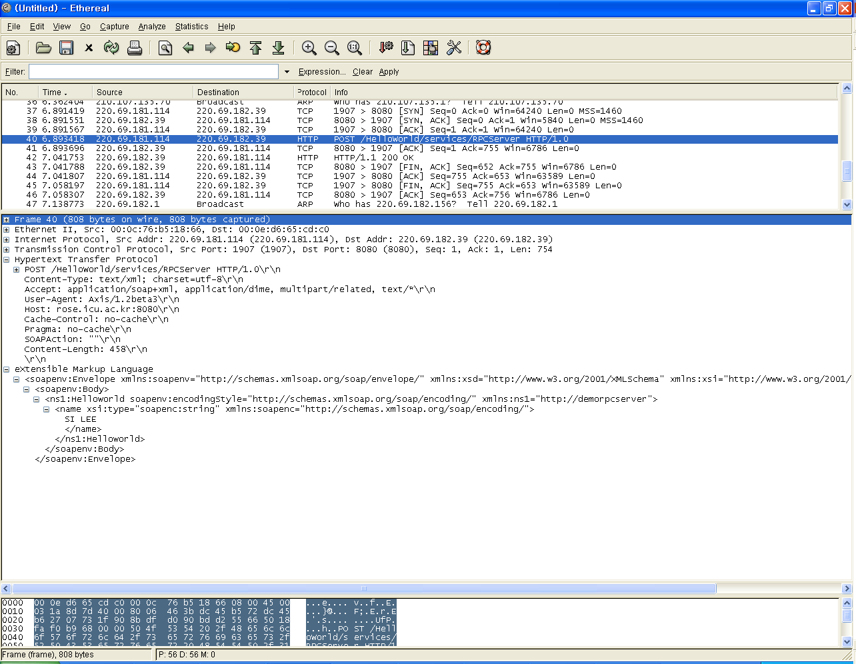

Slide 28
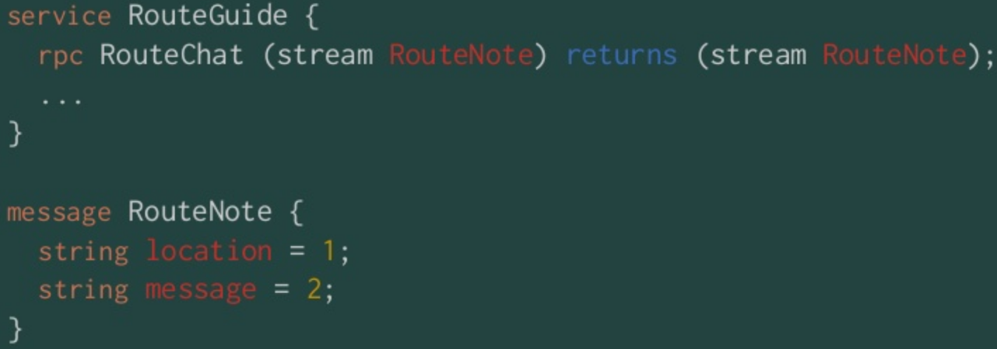
gRPC and Interface Definition
gRPC uses Protocol Buffers as the Interface Definition Language (IDL) for describing both the service interface and the structure of the payload messages.
gRPC provides Protocol Compiler plugins that generate Client- and Server-side APIs with an interface definition in a .proto file.
Example) Bidirectional Streaming RPC Definition

Slide 29
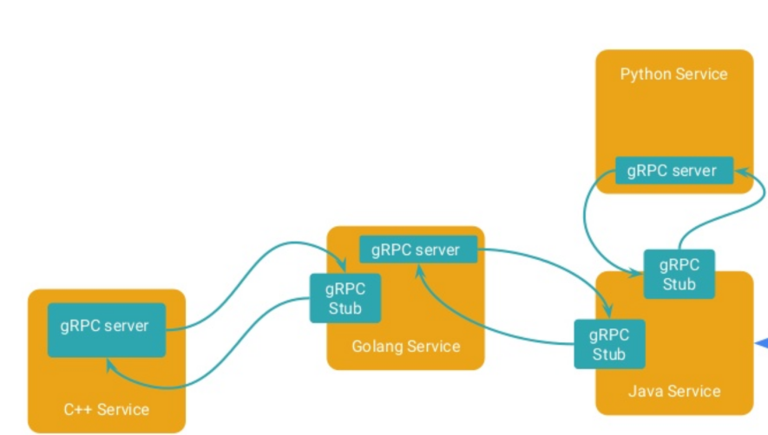
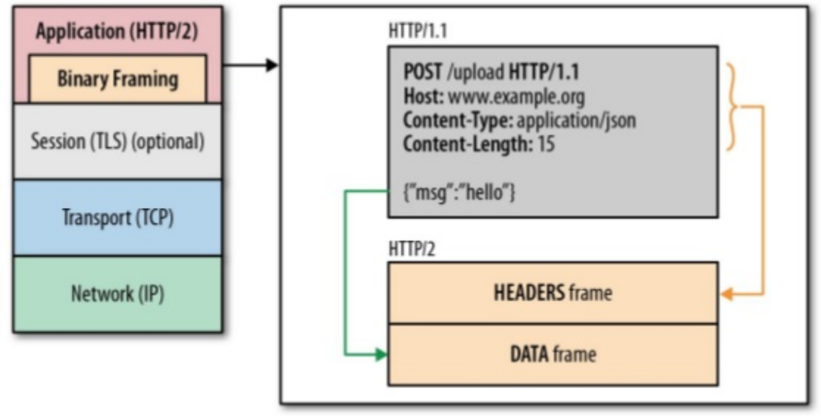
gRPC over HTTP/2
The abstract protocol defined above is implemented over HTTP/2.
gRPC bidirectional streams are mapped to HTTP/2 streams.
The contents of Call Header and Initial Metadata are sent as HTTP/2 headers and subject to HPACK compression.
Payload Messages are serialized into a byte stream of length prefixed gRPC frames which are then fragmented into HTTP/2 frames at the sender and reassembled at the receiver.
Status and Trailing-Metadata are sent as HTTP/2 trailing headers.
gRPC inherits the flow control mechanisms in HTTP/2 and uses them to enable fine-grained control of the amount of memory used for buffering in-flight messages.

Slide 30
Protocol Buffer
The Prototype Buffer is a serialized data structure developed by Google and released as open source.
Serialization is the act of storing data in a binary stream for storage in a file or for transmission over a network.
It supports various languages such as C ++, C #, Go, Java, Python, Object C, Javascript, Ruby, etc. Serialization speed is fast and serialized file size is small.

Slide 31
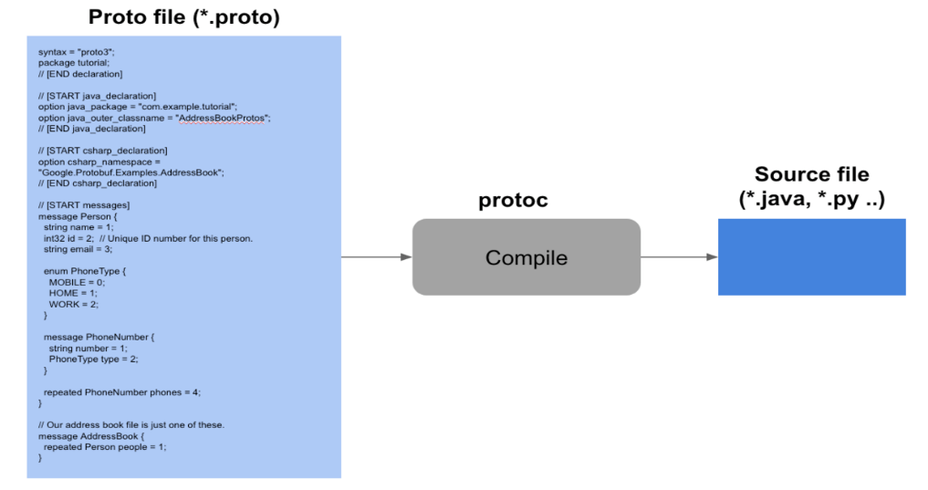
Protobuf Compile
To use the protocol buffer, define the data type to be stored as proto file. Define a datatype that has no dependency on a particular language.
When you compile the proto file with the protoc compiler, you create a data class file of the appropriate type for each language.
<An example of compiling with Python>
protoc -I=./ --python_out=./ ./address.proto
import address_pb2
person = address_pb2.Person()
person.name = 'Terry'
person.age = 42
person.email = 'terry@mycompany.com'
f = open('myaddress','wb')
f.write(person.SerializeToString())
f.close()

Slide 32
Protobuf to JSON
When implementing a REST API such as HTTP / JSON from a client (mobile) to a server, it is necessary to serialize JSON into protocol buffer format before transmission, to transmit the packet with a reduced overall packet amount.
API gateway is placed in front of the back-end server, and the message body that comes in the protocol buffer is converted into JSON and passed to the back-end API server.
from google.protobuf.json_format import MessageToJson
jsonObj = MessageToJson(person)
print jsonObj
{
"age": 42,
"name": "Terry",
"email": "terry@mycompany.com"
}

Slide 33
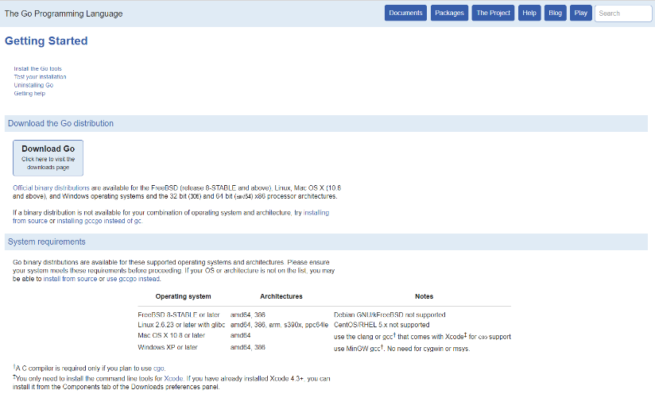
gRPC Environment Setting (Linux)
Golang Installation
Install Golang binaries
https://golang.org/doc/install?cm_mc_uid=02652595810614900694309&cm_mc_sid_50200000=1490500863
Install the downloaded compressed file through the following command
Setting Environment Variables in $ HOME / .profile
tar -C /usr/local -xzf <다운로드 받은 압축파일>
$HOME 아래에 work라는 디렉토리 생성
mkdir $HOME/work
export GOROOT=/usr/local/go
export GOPATH=$HOME/work
export PATH=$PATH:$GOROOT/bin:$GOPATH/bin

Slide 34
gRPC Environment Setting (Linux)
Check Golang Execution
hello.go
Build source code
Execute
Package main
import "fmt"
func main() {
fmt.Printf("hello, world\n")
}
cd $GOPATH/src/hello
go build
./hello
hello, world

Slide 35
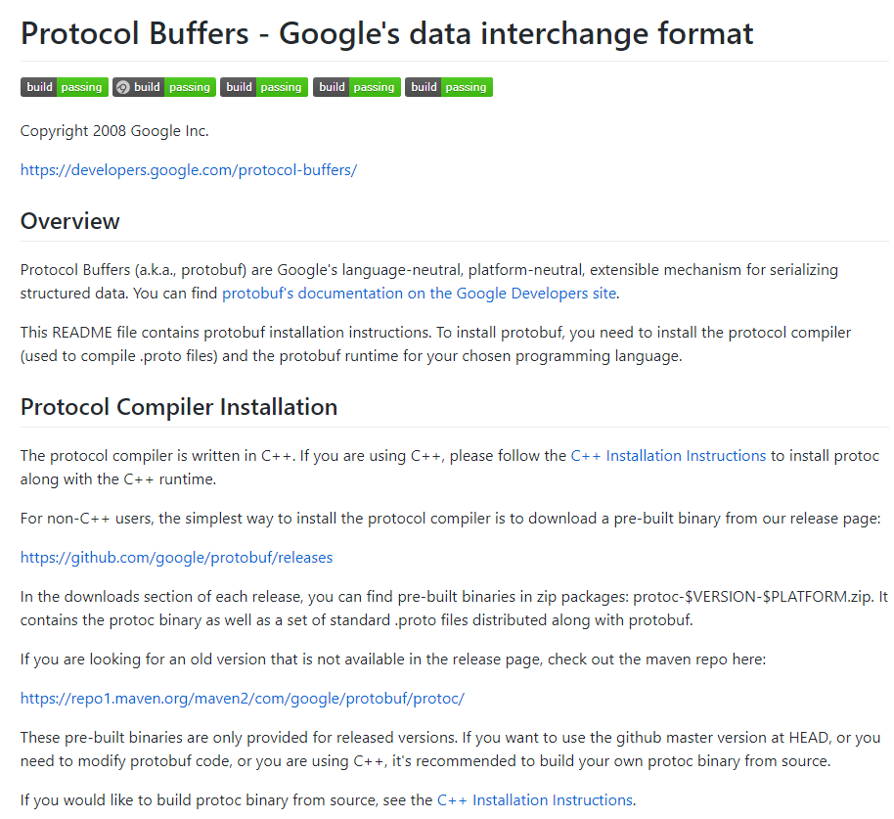
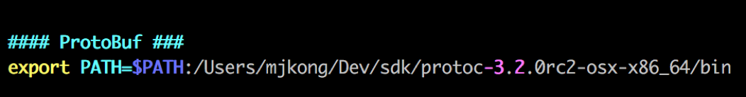
Install Protocol Buffer
Download Protocol Buffer Archive
https://github.com/google/protobuf/releases
Unarchive and register to $PATH
Install Protobuf Golang plugin
go get -u github.com/golang/protobuf/{proto,protoc-gen-go}

Slide 36
gRPC Example
Hello world example
[dir] greeter_client – Client code
[dir] greeter_server – Server code
[dir] helloworld - protobuf file specify the gRPC service. With command ‘protoc’ .pb.go file will be created and it specify the message type of server-client communication
Run Server Code
Run Client Code
Check out message “Greeting: Hello world”
cd $GOPATH/src/google.golang.org/grpc/helloworld
go run greeter_server/main.go
go run greeter_client/main.go

Slide 37
gRPC Example
Service Update
Build gRPC Code
$GOPATH/src/google.golang.org/grpc/examples/helloworld/helloworld/helloworld.proto
// The greeting service definition.
service Greeter {
// Sends a greeting
rpc SayHello (HelloRequest) returns (HelloReply) {}
// Sends another greeting
rpc SayHelloAgain (HelloRequest) returns (HelloReply) {}
}
// The request message containing the user's name.
message HelloRequest {
string name = 1;
}
// The response message containing the greetings
message HelloReply {
string message = 1;
}
protoc -I helloworld/ helloworld/helloworld.proto --go_out=plugins=grpc:helloworld

Slide 38
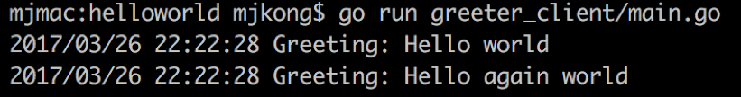
gRPC Example
Service Update
Server code updated
Client code updated
Execution Result
func (s *server) SayHelloAgain(ctx context.Context, in *pb.HelloRequest) (*pb.HelloReply, error) {
return &pb.HelloReply{Message: "Hello again " + in.Name}, nil
}
r, err = c.SayHelloAgain(context.Background(), &pb.HelloRequest{Name: name})
if err != nil {
log.Fatalf("could not greet: %v", err)
}
log.Printf("Greeting: %s", r.Message)

Slide 39
Node.js gRPC Example (Protobuf)
service BookService {
rpc List (Empty) returns (BookList) {}
rpc Insert (Book) returns (Empty) {}
rpc Get (BookIdRequest) returns (Book) {}
rpc Delete (BookIdRequest) returns (Empty) {}
rpc Watch (Empty) returns (stream Book) {}
}
message Empty {}
message Book {
int32 id = 1;
string title = 2;
string author = 3;
}
message BookList {
repeated Book books = 1;
}
message BookIdRequest {
int32 id = 1;
}

Slide 40
Node.js gRPC Example (Server)
var grpc = require('grpc');
var booksProto = grpc.load('books.proto');
var server = new grpc.Server();
server.bind('0.0.0.0:50051',
grpc.ServerCredentials.createInsecure());
console.log('Server running at http://0.0.0.0:50051');
server.start();
server.addService(booksProto.books.BookService.service, {
list: function(call, callback) {
callback(null, books);
},
insert: function(call, callback) {
var book = call.request;
books.push(book);
callback(null, {});
},
get: function(call, callback) {
for (var i = 0; i < books.length; i++)
if (books[i].id == call.request.id)
return callback(null, books[i]);
callback({
code: grpc.status.NOT_FOUND,
details: 'Not found'
});
},
delete: function(call, callback) {
for (var i = 0; i < books.length; i++) {
if (books[i].id == call.request.id) {
books.splice(i, 1);
return callback(null, {});
}
}
callback({
code: grpc.status.NOT_FOUND,
details: 'Not found'
});
}
});

Slide 41
Node.js gRPC Example (Client)
function insertBook(id, title, author) {
var book = { id: parseInt(id), title: title, author: author };
client.insert(book, function(error, empty) {
printResponse(error, empty);
});
}
function getBook(id) {
client.get({ id: parseInt(id) }, function(error, book) {
printResponse(error, book);
});
}
function deleteBook(id) {
client.delete({ id: parseInt(id) }, function(error, empty) {
printResponse(error, empty);
});
}
var grpc = require('grpc');
var booksProto = grpc.load('books.proto');
var client = new booksProto.books.BookService('127.0.0.1:50051',
grpc.Credentials.createInsecure());
function printResponse(error, response) {
if (error)
console.log('Error: ', error);
else
console.log(response);
}
function listBooks() {
client.list({}, function(error, books) {
printResponse(error, books);
});
}

Slide 42
Result
$ node client.js delete 123
{}
$ node client.js list
{ books:
[ { id: 2,
title: 'The Three Musketeers',
author: 'Alexandre Dumas' } ] }
$ node client.js get 2
{ id: 2,
title: 'The Three Musketeers',
author: 'Alexandre Dumas' }
$ node client.js insert 2 "The Three Musketeers" "Alexandre Dumas"
{}
$ node client.js list
{ books:
[ { id: 123,
title: 'A Tale of Two Cities',
author: 'Charles Dickens' },
{ id: 2,
title: 'The Three Musketeers',
author: 'Alexandre Dumas' } ] }

Slide 43
Lab 5. RPC Programming
Read text materials and test practices
Use your notebook PC to examine context and produce the source code when you finish the successful practice.
Objectives
Understand the process of RPC
Learn the how to analyze network packet using wireshark
Understand packet structure of RPC

Slide 44
Lab Requirements
Follow the steps to deploy and call the gRPC service with another project names
Modify gRPC service to implement book store
BookRentalShop (gRPC Server)
Remote Head Office
(gRPC Client)
addBook(book)
Customer
(gRPC Client)
rentBook(bookID)
return book
removeBook(bookID)
return ‘book remove status’
returnBook(book)
return ‘book return status’
bookShelf
rentedBookList
totalAccount
getAccount()
return account
* Add $2 per rent to account
* Handle the exceptions within the acceptable range

Slide 45
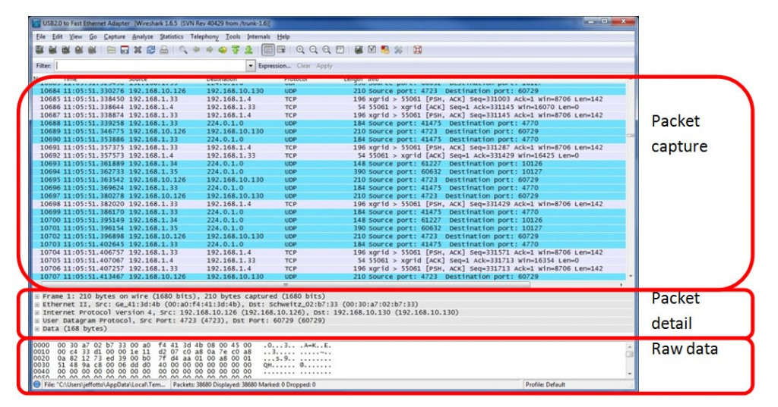
Lab. Analyzing RPC packets with Wireshark
Prerequisite) WinPcap is the library for capturing packets and looking network status. WinPcap can be downloaded in following address. http://www.winpcap.org/install/default.htm
We can also download Wireshark in https://www.wireshark.org/download.html

Slide 46
Service Senario
Service Health Check Interface
syntax = "proto3";
package servicestatus;
service HealthCheck {
rpc Status (StatusRequest) returns (HealthCheckResult) {}
}
message StatusRequest {
}
message HealthCheckResult {
string Status = 1;
}
var hello_proto = grpc.load(PROTO_PATH).helloworld;
var servicestatus_proto = grpc.load(__dirname + "/servicestatus.proto").servicestatus;
function sayHello(call, callback) {
callback(null, {message: 'Hello ' + call.request.name});
}
function statusRPC(call, callback) {
console.log("statusRPC", call);
callback(null, {Status: 'MagicResponseCodeOK'});
}
function main() {
var server = new grpc.Server();
server.addProtoService(hello_proto.Greeter.service, {sayHello: sayHello});
server.addProtoService(servicestatus_proto.HealthCheck.service, { status: statusRPC });
server.bind('0.0.0.0:50051', grpc.ServerCredentials.createInsecure());
server.start();
}
Server Stub
RPC Service Interface Definition (Protobuf)
var servicestatus_proto = grpc.load(PROTO_PATH).servicestatus;
function main() {
var client = new servicestatus_proto.HealthCheck('localhost:50051', grpc.credentials.createInsecure());
client.status({}, function(err, response) {
console.log('Greeting:', response);
});
}
Client Stub

Slide 47
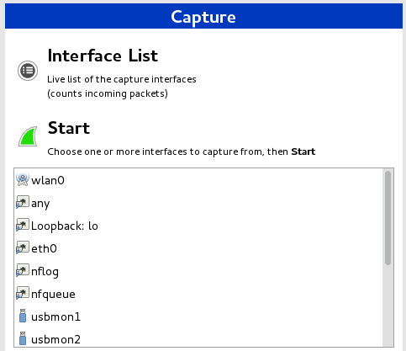
RPC operation (1)
Identifying RPC operation with Wireshark
After starting Wireshark, you can find a button which is in above red box. Click the button.
Select the appropriate network interface (eth0, eth1, wifi, virtual bridge and etc.)

Slide 48
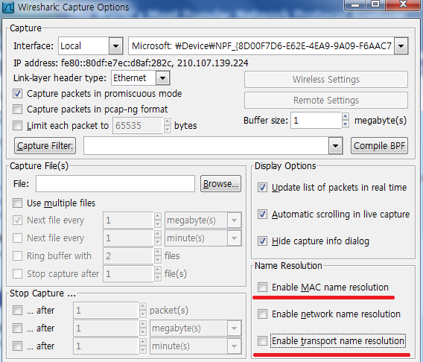
RPC operation (2)
Complete the following configuration as shown.

Slide 49
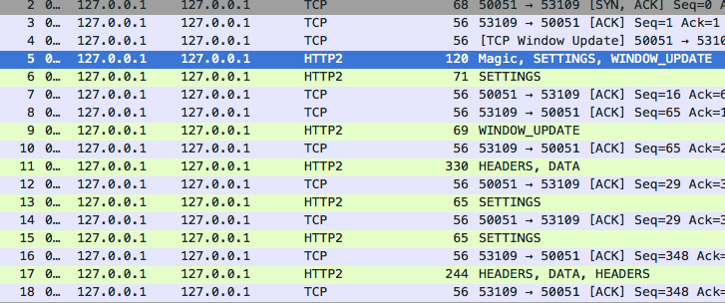
RPC operation (3)
After configuration, we can see the RPC operation results.

Slide 50
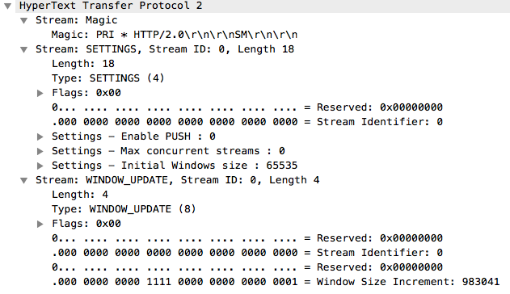
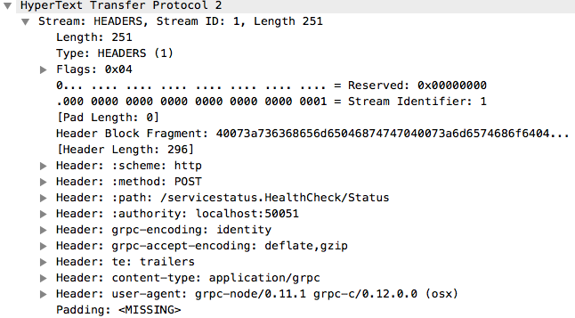
RPC operation (4)
HTTP/2 typed gRPC packets
Payload is encoded in protobuf serialization

Slide 51
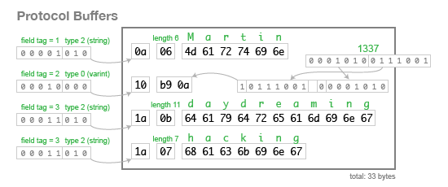
Protobuf serialization
{
"userName": "Martin",
"favouriteNumber": 1337,
"interests": ["daydreaming", "hacking"]
}
message Person {
required string user_name = 1;
optional int64 favourite_number = 2;
repeated string interests = 3;
}
JSON
Protobuf Schema

